Slide 1


Unequal Odds? Social roots of sepsis
Team 3: Pankaj Agarwal, Rafi Attrach, Brian Learner, Bryce Hendren, Preethi Krishnan

Slide 2

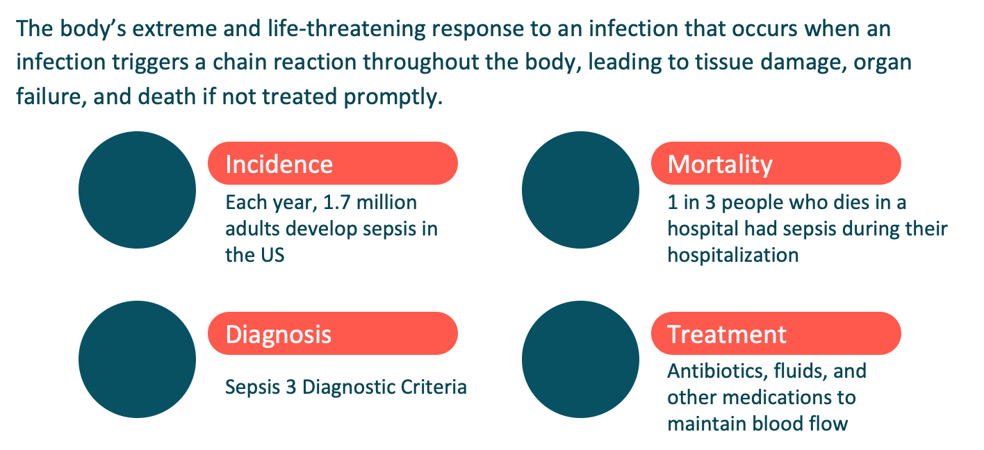




What is sepsis?

Slide 3
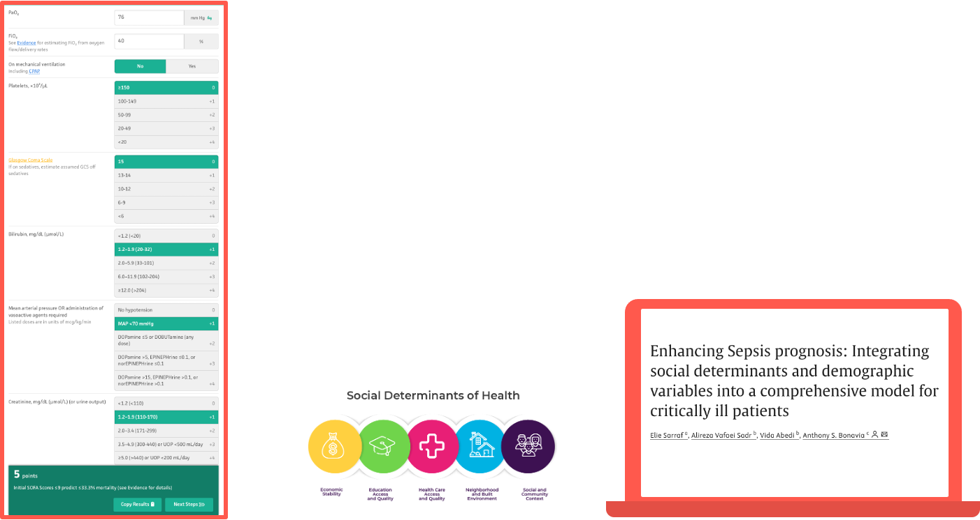

Slide 4




Methods
Day 2
Day 30
48 hours post-ICU admission
Mortality at 30 days
Day 1
Day 3
Presentation to ICU
72 hours post-ICU admission

Slide 5
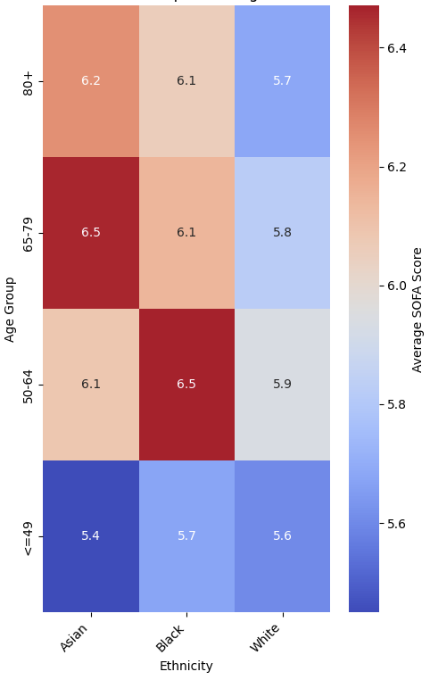
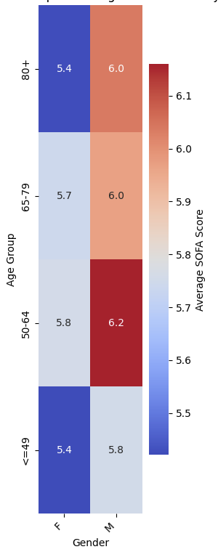
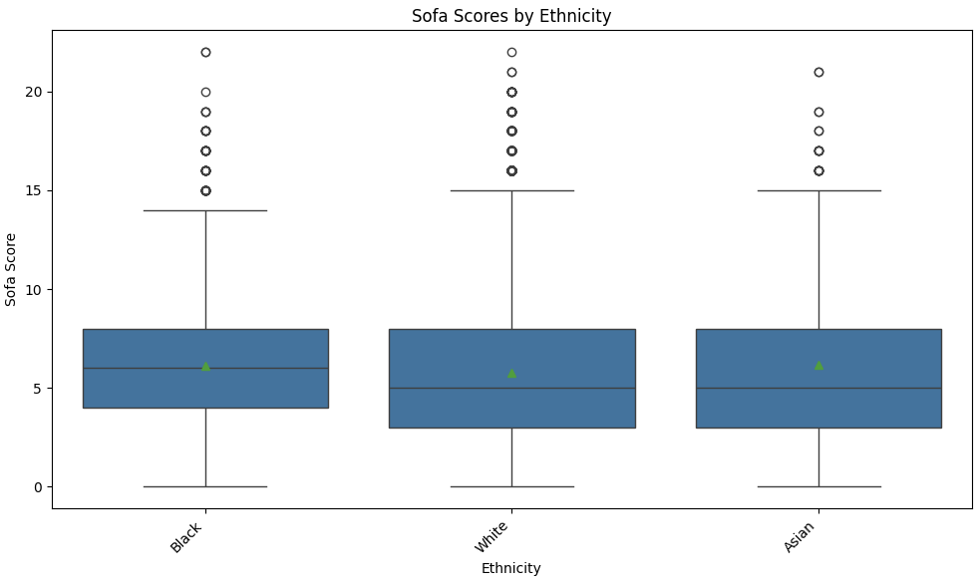
EDA

Slide 6
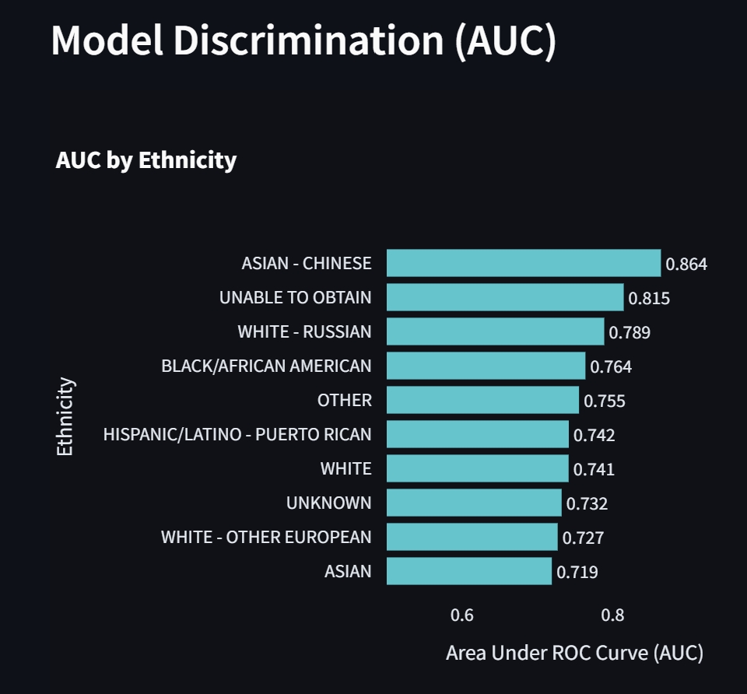

Slide 7
Results

Slide 8
Conclusions
Initial SOFA focus
Temporal dynamics
Complex interactions
Based on physiologic parameters in 24hrs relevant to acute presentation
Initially everyone looks “bad” but acute physiology doesn’t diverge that soon on social groups
Hospital/system-level biases may be perpetuated over time

Slide 9
Future Work

